Slide 1
What’s in our water?
Di Liu, Naufa Amirani, and Aziz Zafar

Slide 2
Outline
Motivation for our project
Web app and visualization choices
Limitations and improvements

Slide 3
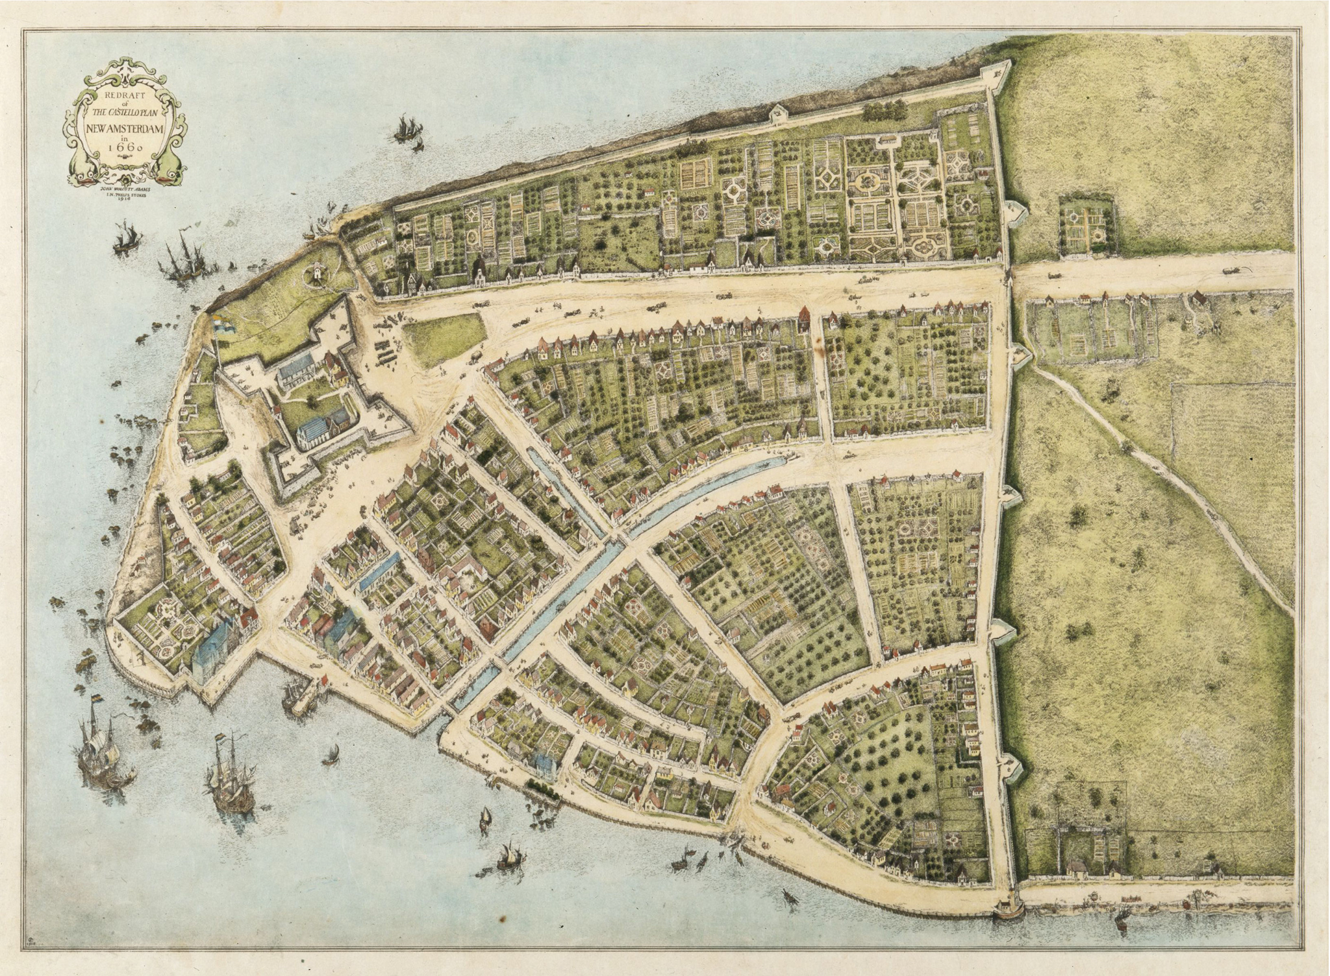
History of environmental injustice in New York
Dates back to early Dutch colonization (17th century)
Clean drinking water is a right by law
Patterns of disparities by population demographics
Are there correlation to health outcomes?
Source

Slide 4
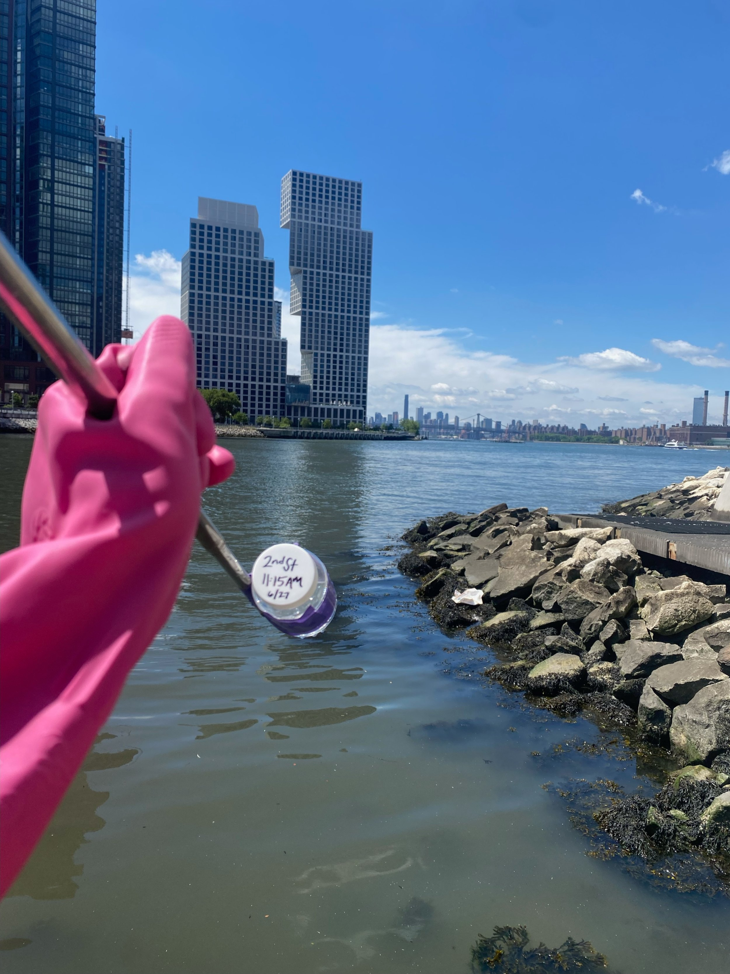
About our data
Water quality
~1-4 sites per neighborhood
Chlorine, Fluoride, Turbidity, and microbes
Repeated measures for past decade
Chlorine - used for disinfecting but has an upper limit
Turbidity - measure of water cloudiness
Health and demographics
Grouped by neighborhood (NTA 2010)
Population adjusted
Health census from 2010 - 2014
Focused on
Maternal outcomes, water-borne illnesses, and Tuberculosis
Ethnicity
Poverty and education
Source

Slide 5
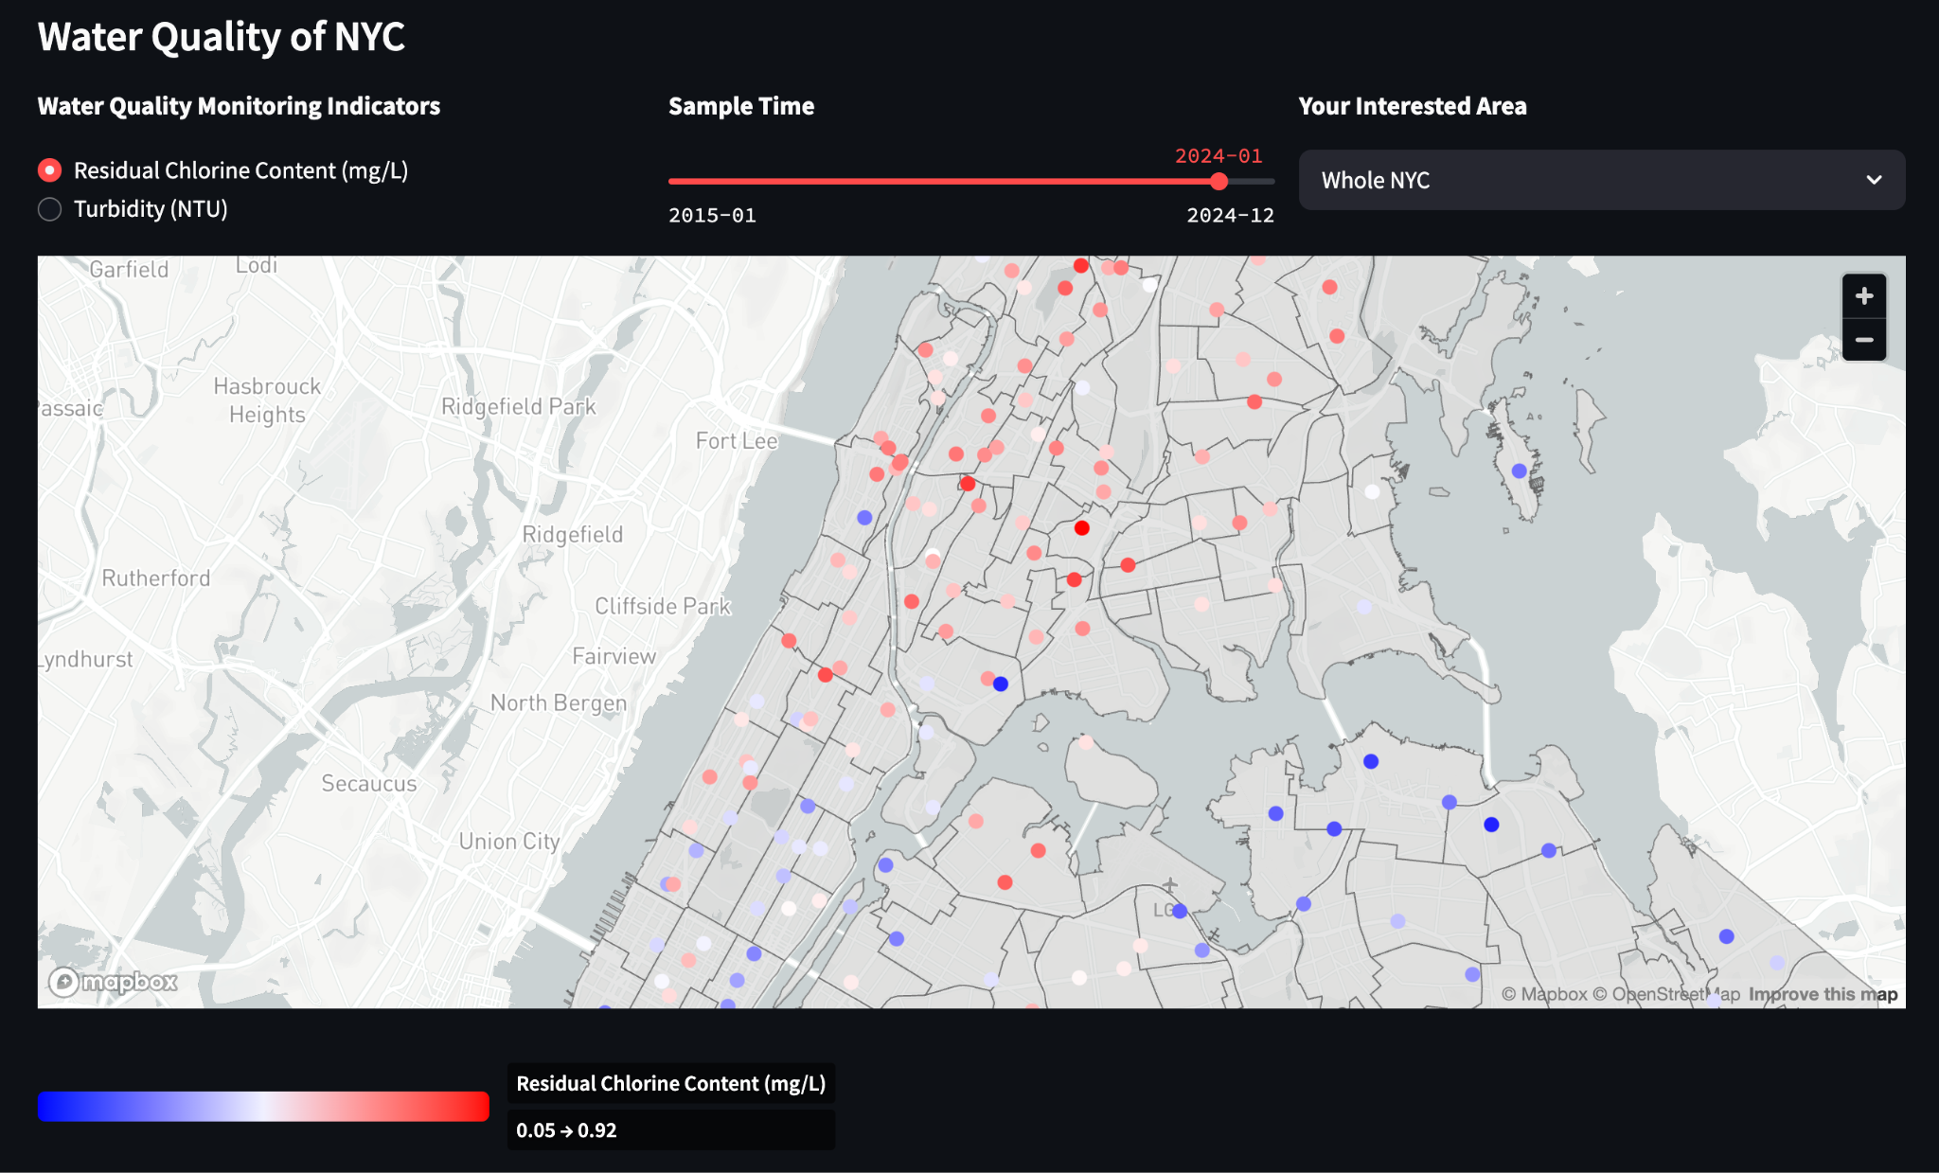
Mapping of water quality over time
Allows investigation of time periods
Visualizes exact sites and how they represent the neighborhood

Slide 6
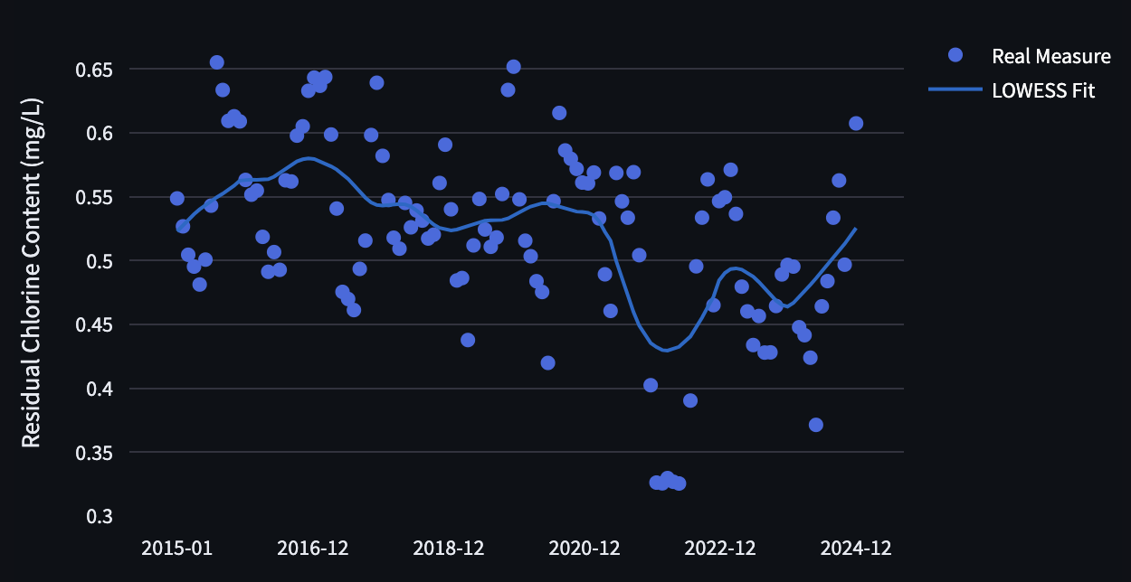
Time series analysis of water quality
Especially important for non-linear patterns of change over time

Slide 7
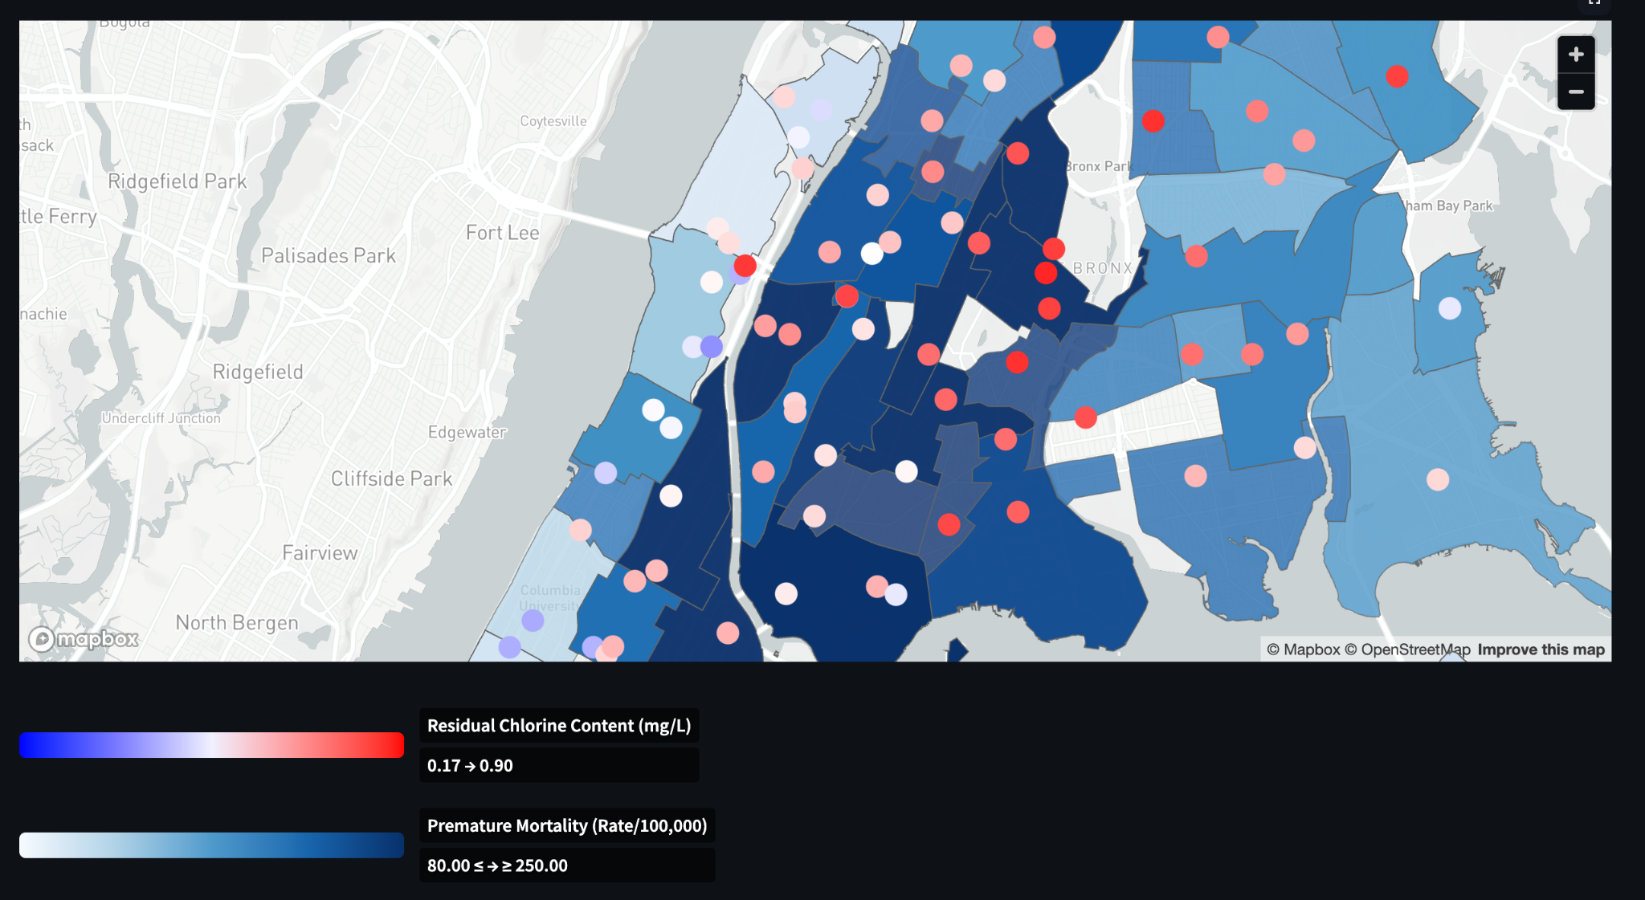
Overlaying multiple variables on maps
Allows to visualize areas with disparate values and geographic patterns

Slide 8
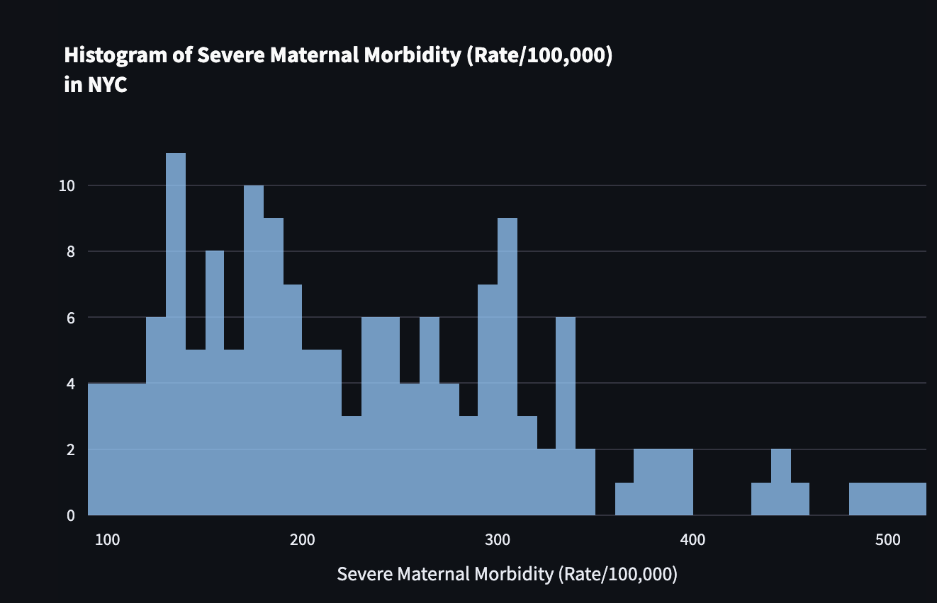
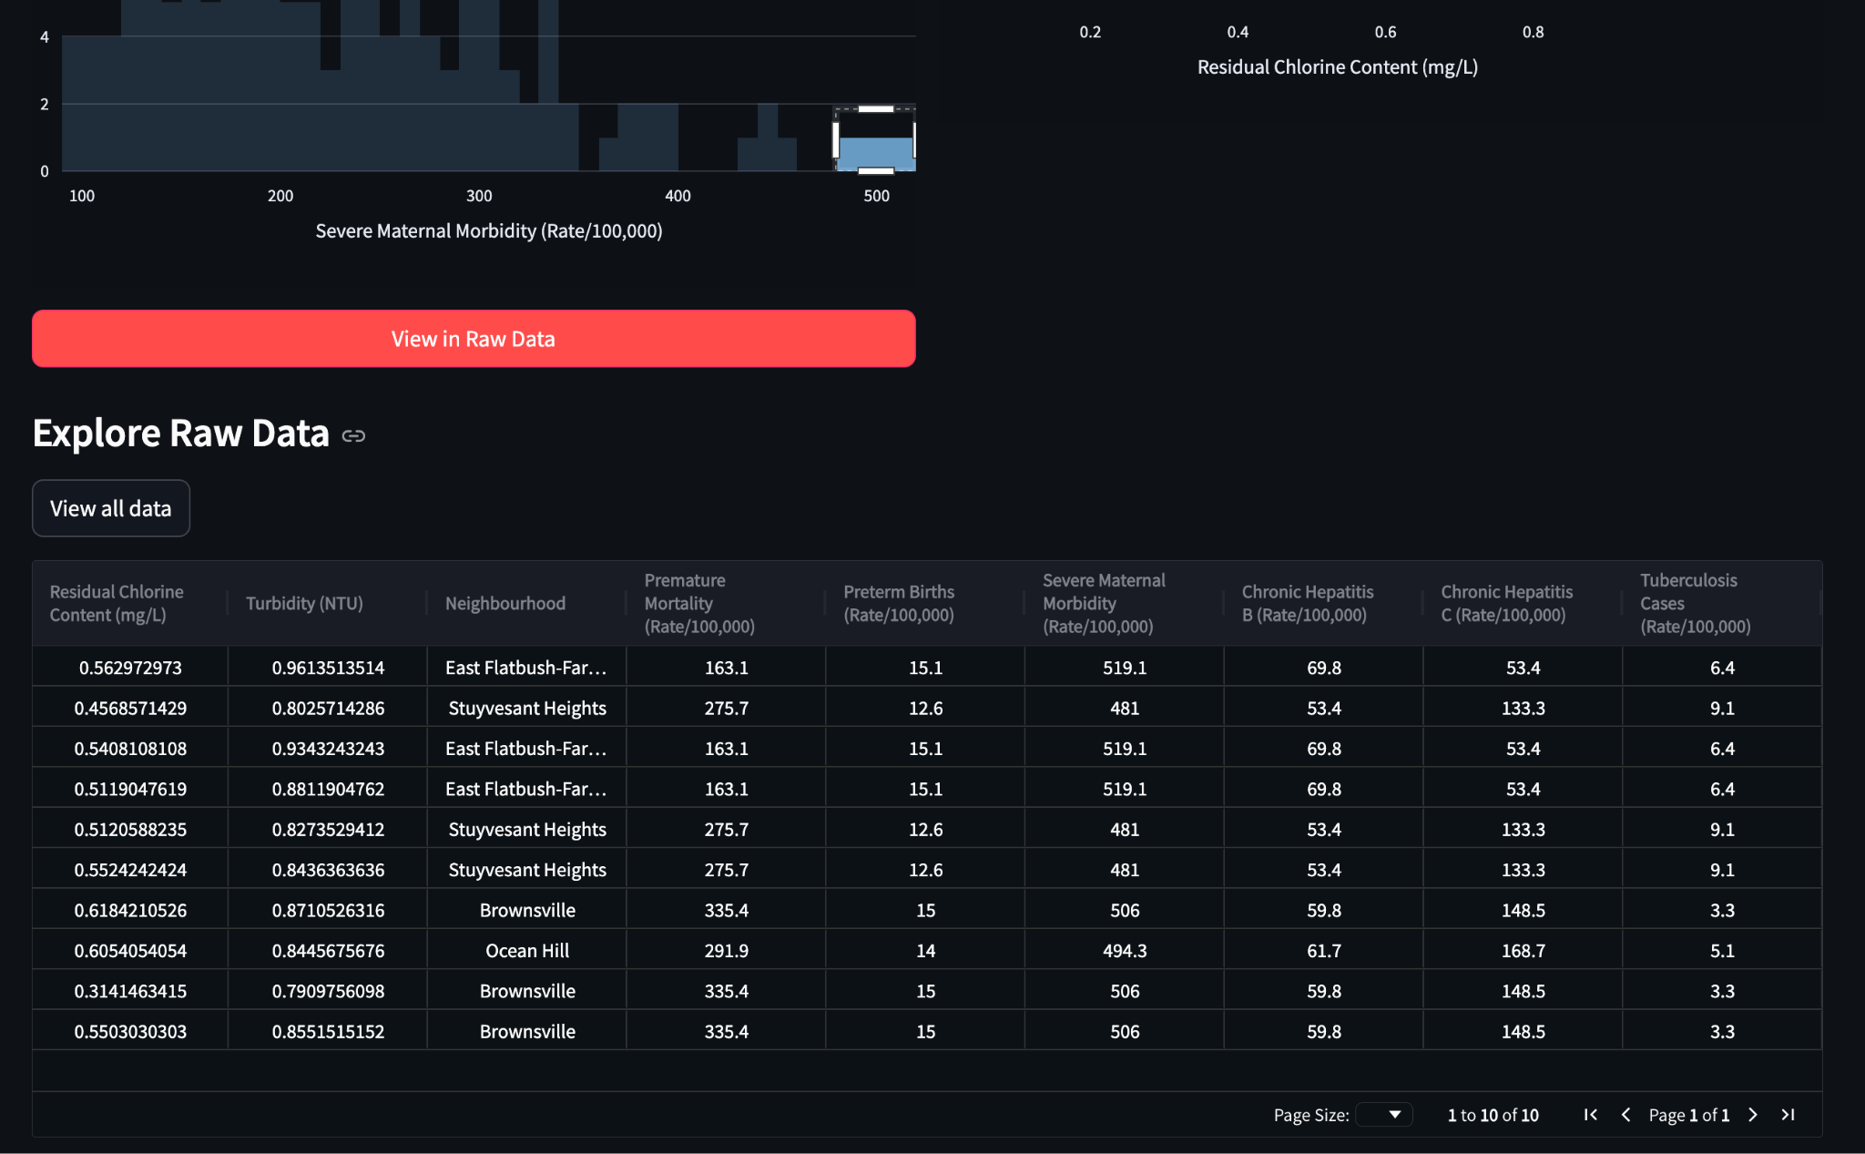
Interactive histograms
Investigating outliers using an interactive data viewer

Slide 9
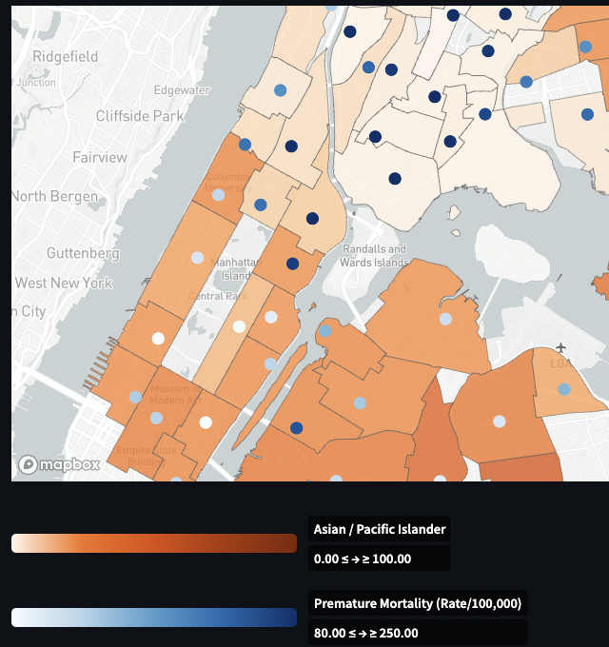
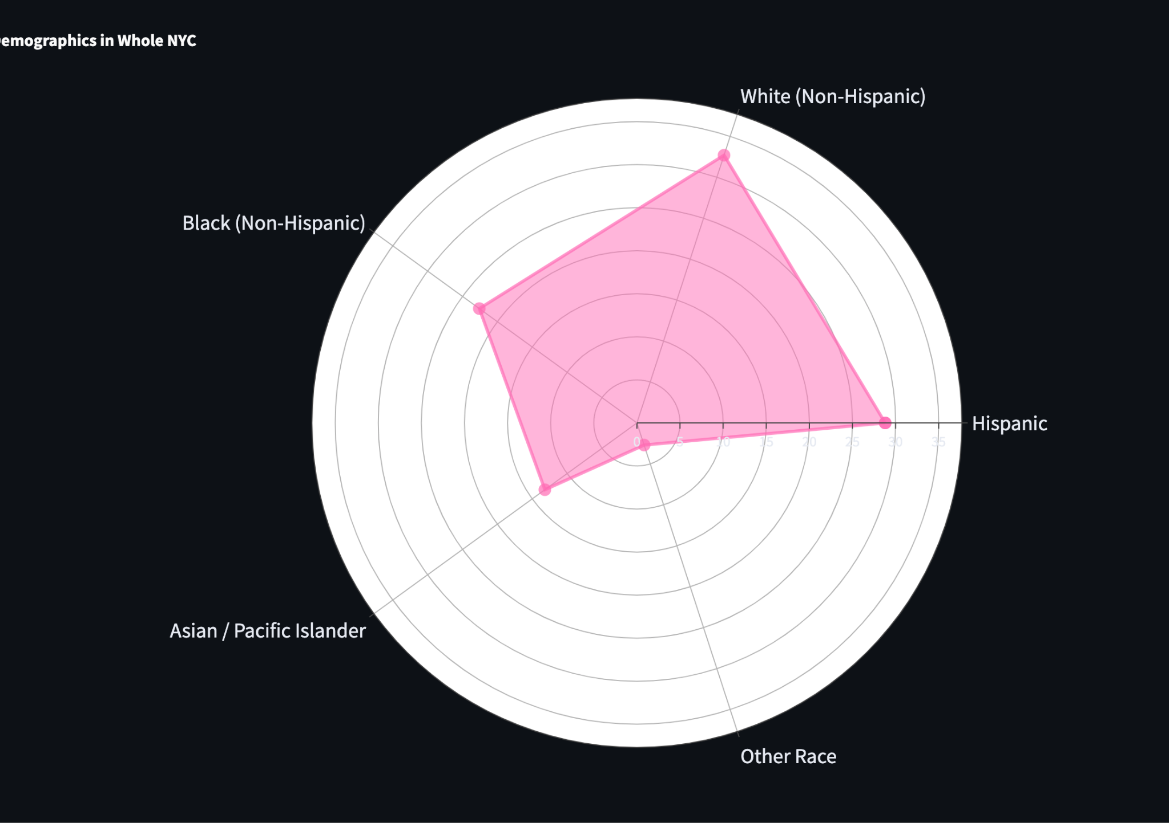
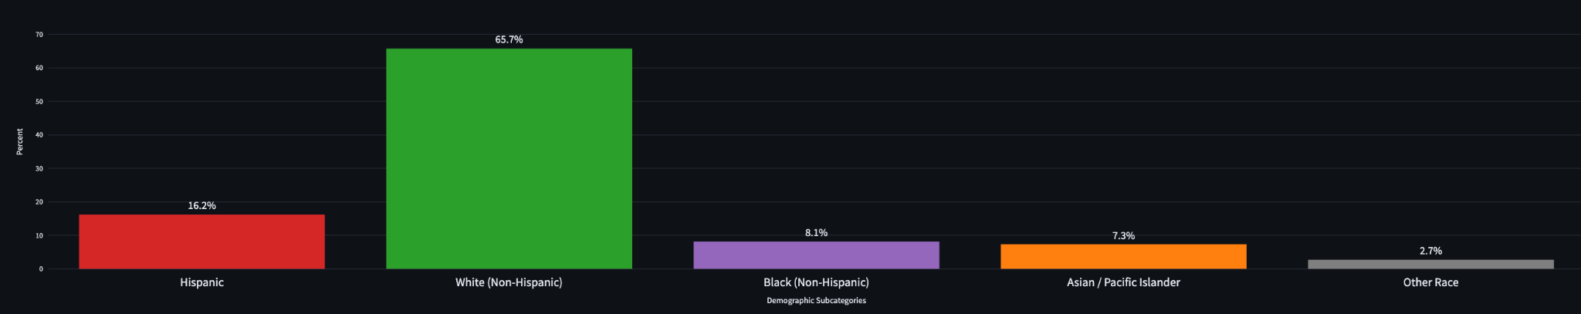
Plotting demographics by neighborhood
1)
Display of demographic group distribution may be toggled between:
Radar chart
Bar chart
2)

Slide 10
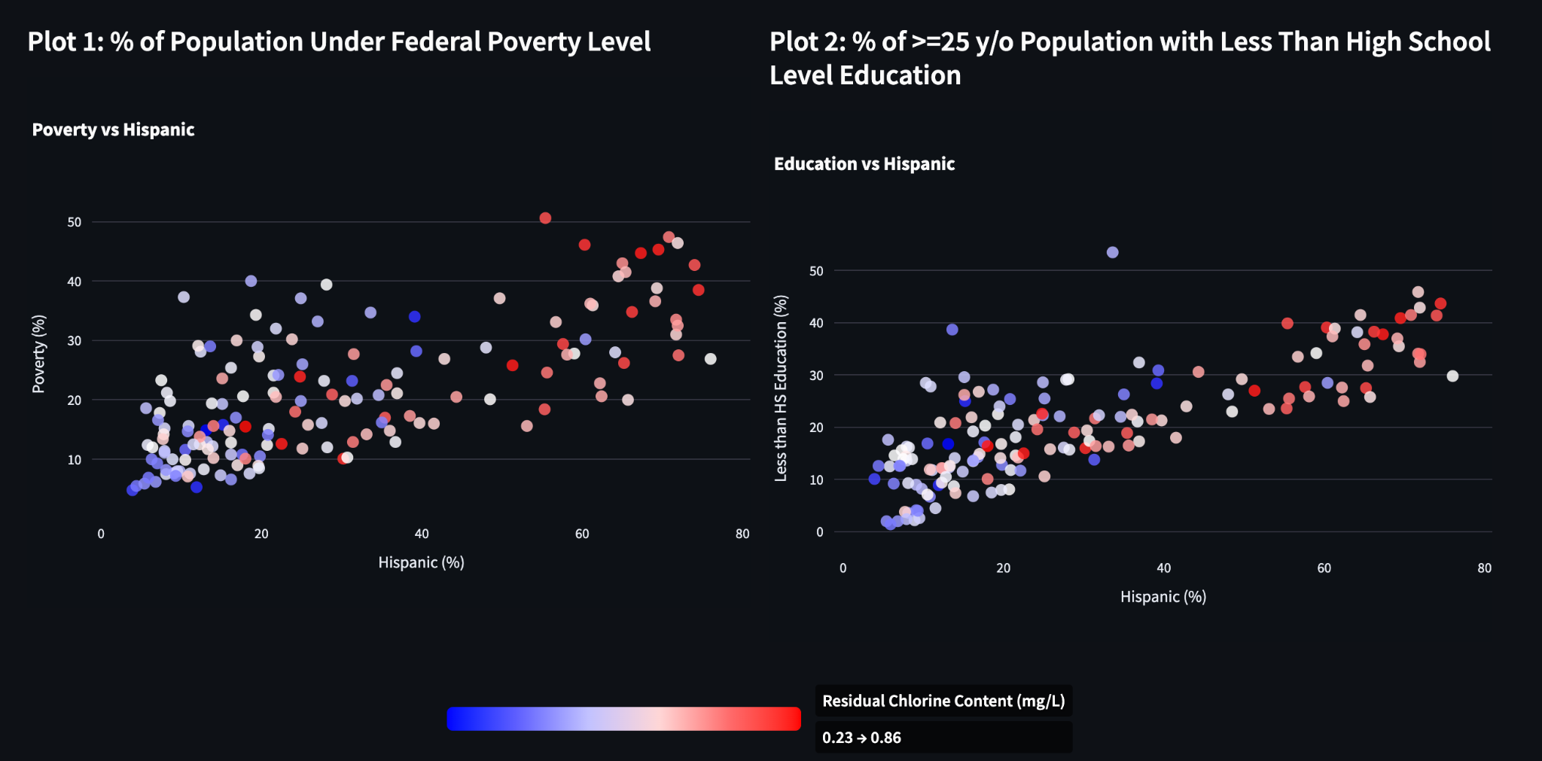
Understanding 3-dimensional relationships
Allows toggling of demographic group and water metric in regards to poverty/education

Slide 11
Limitations and potential improvements
Census is from 2010 - 2014, whereas water quality measurements are 2015~
Time granularity and overlap would help
Education information is very limited
Only High School level
Multi-dimensional statistical analysis and causal inference needed for rigorous understanding
Improvements:
Information on water pipe maintenance, history of buildings
Leverage water quality reports with text for richer embedding

